Slide 1
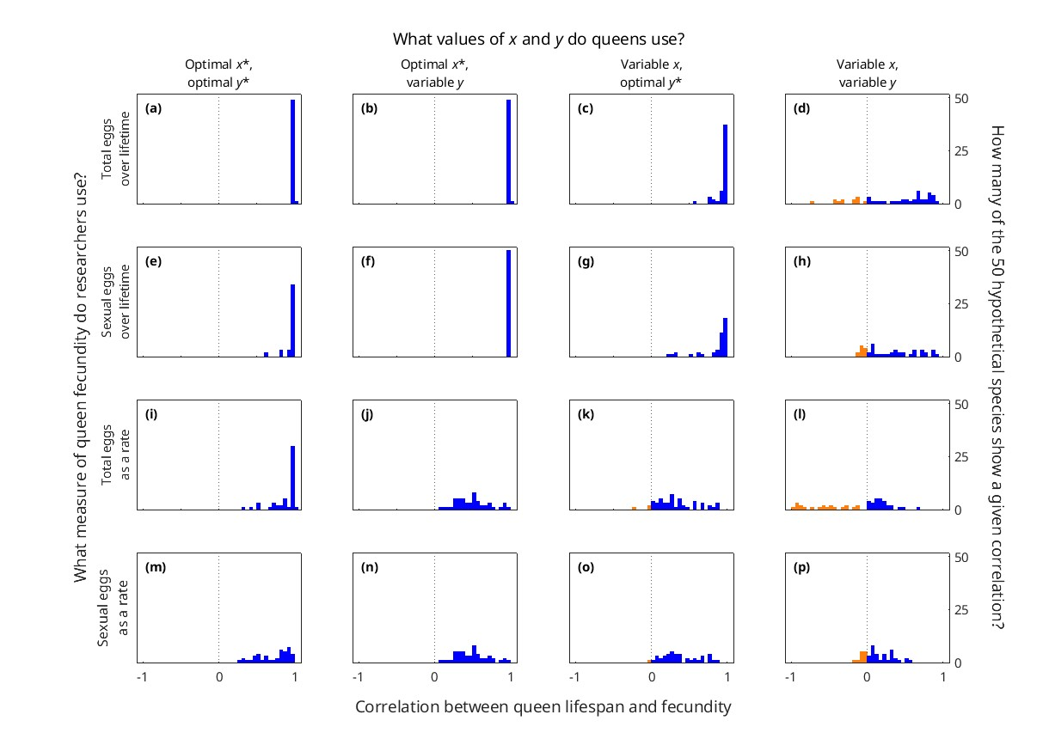
Figure 4 based on {x*, y*} pairs found using polynomial regression (what we did)

Slide 2
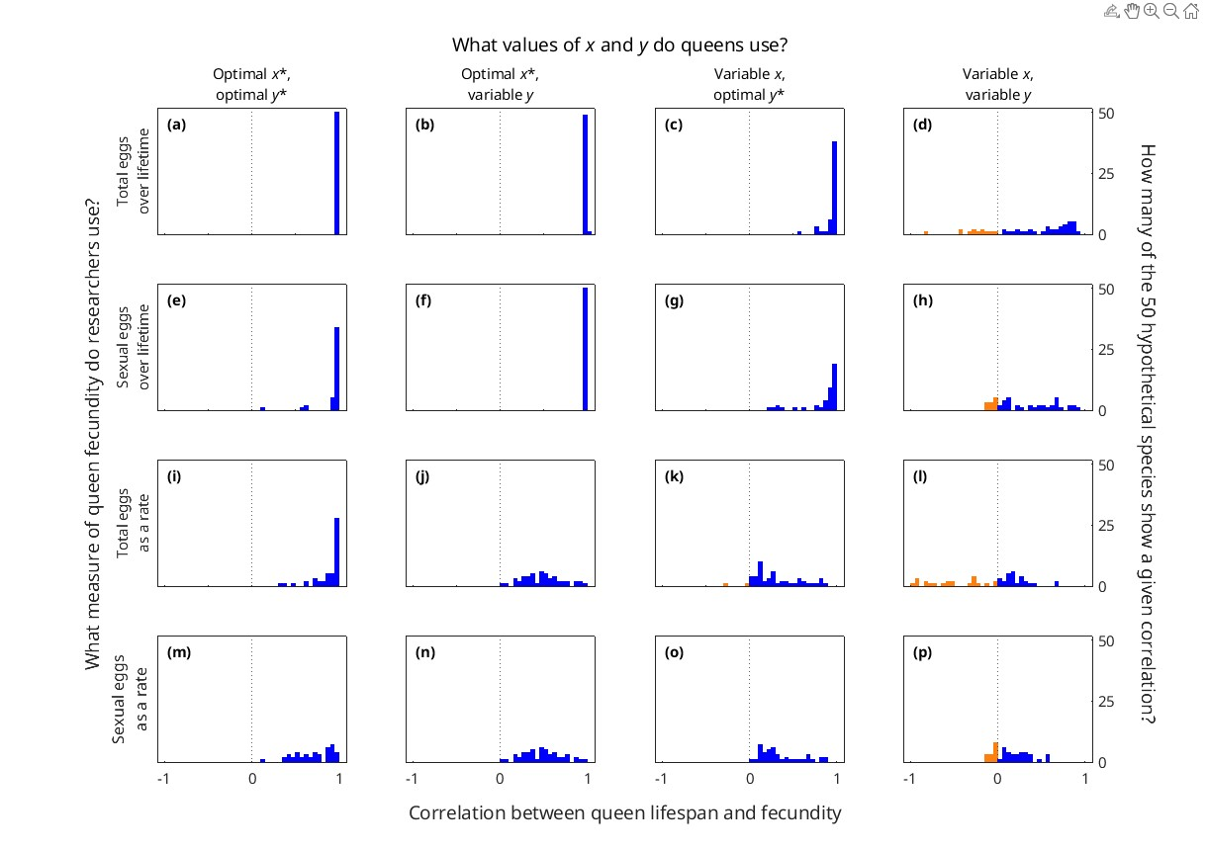
Figure 4 based on {x*, y*} pairs found using regression splines (GAM) (suggested by one reviewer)

Slide 3
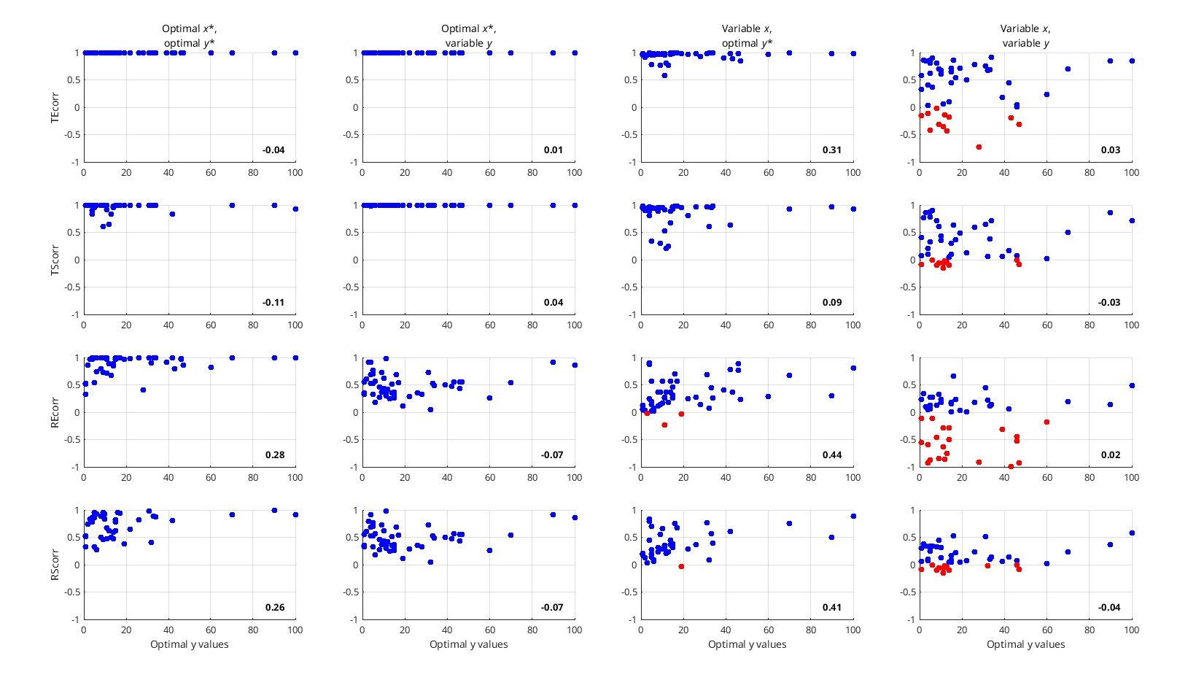
For high y* values, we only find positive correlations between queen lifespan and fecundity (polynomial approach)

Slide 4
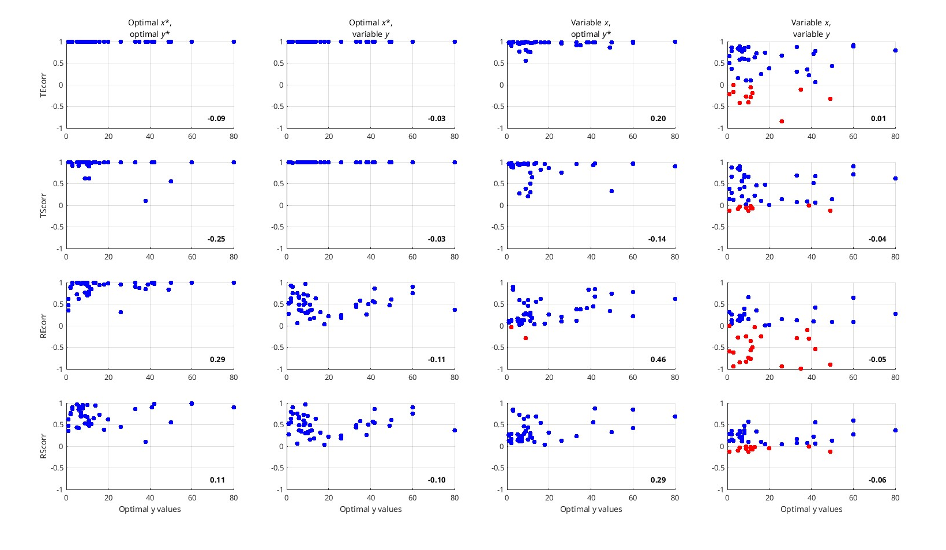
For high y* values, we mostly find positive correlations between queen lifespan and fecundity (spline approach)

